Slide 1
ELEC 460 Control Theory and Systems II
Digital Controllers for Analog Systems
Transfer Function Approach
Lead, Lag, PID controllers
State-Space Approach
State Feedback controllers
Controller Implementation

Slide 2
ELEC 483 Digital Video Processing
Multidimensional Data (Space/Time)
Video Coding Concepts
Hybrid Coding, Scalable Coding ……
Video Coding Standards
MPEG, H263, H264 ….
Video Standard Conversion
NTSC <-> PAL,SECAM;
interlaced <-> progressive

Slide 3
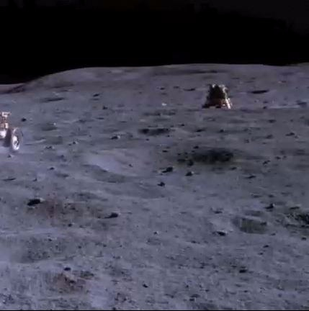
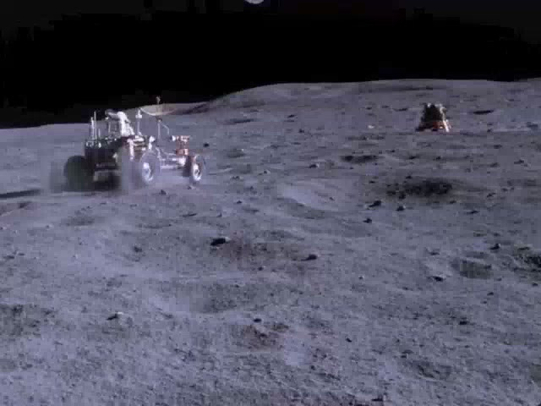
ELEC 483 Project Example

